Slide 1
Hi AI Student Ambassador!
We were looking for you :)
Welcome
AI Student Ambassador
AI Student Ambassador Program

Slide 2

AI Ambassador Program Timeline
March
April 14th
April
May
May
Ambassador Marketing
Flyer & Outreaches
Follow-ups
Deadline Applications
- Decision Ambassador
- Notification Ambassador
- Onboarding scheduled end of April
Collect ~ 4 success stories
LinkedIn posts
Start Certification Processes
Mentoring
02.05 oder woche spater .

Slide 3
ONBOARDING DAY
Hello and Welcome
AskBrian & Team Introduction
Ambassador Program Introduction
Your Responsibilities
The Certification Process
Program Rules and Confidentiality
- BREAK -
Technology Deep Dive
Q&A Session
Networking
What are we up to today…

Slide 4
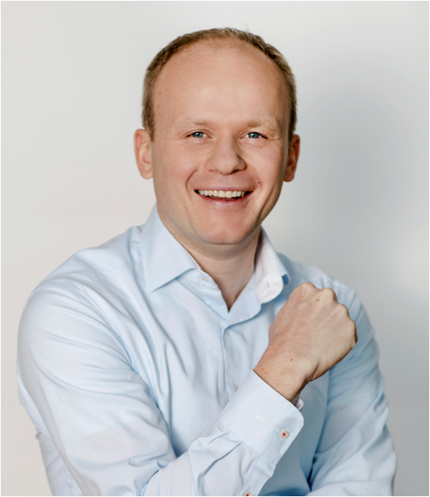
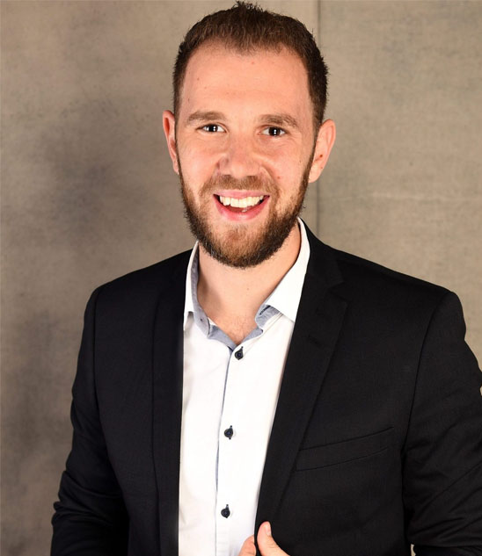
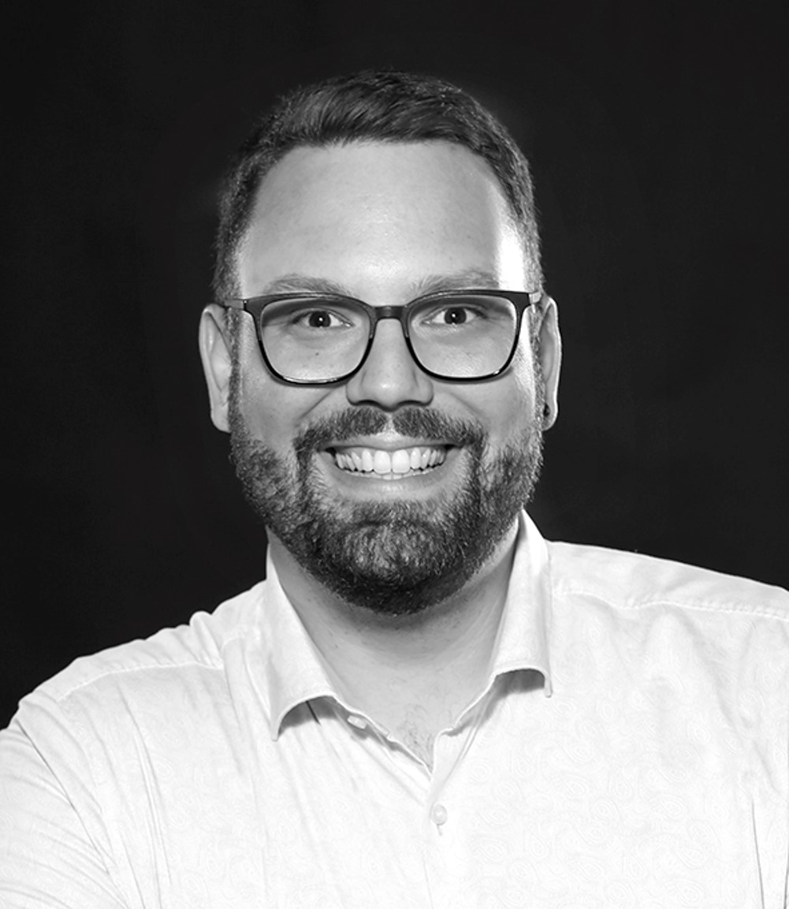
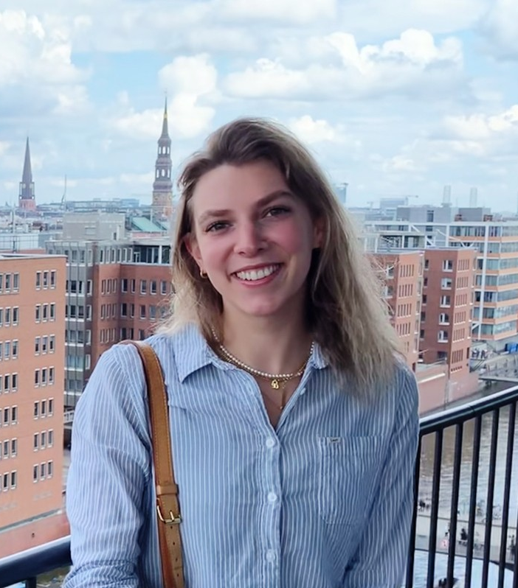
Ambassador Program 2023
Get to know the AskBrian Team
Team Vorstellung Slide Brian
Pavol Sikula
Matthias Ruppel
Rene Karsch
Johanna Wüschner
Founder & CEO
15 years in top management consulting (Roland Berger, Stern Stewart & Co.)
Two-times Ironman
Building Brian since December 2017
Co-founder & CTO
Passionate software developer
Experienced team leader
3 years big data at T-Systems
Business Development Manager
Consulting market insider
5 years of Startup & Corporate experience
Loves his black poodle:)
Working Student BD
Data Science Graduate
Impact Entrepreneurship & Innovation Master @Nova SBE
Passionate about all things digital

Slide 5
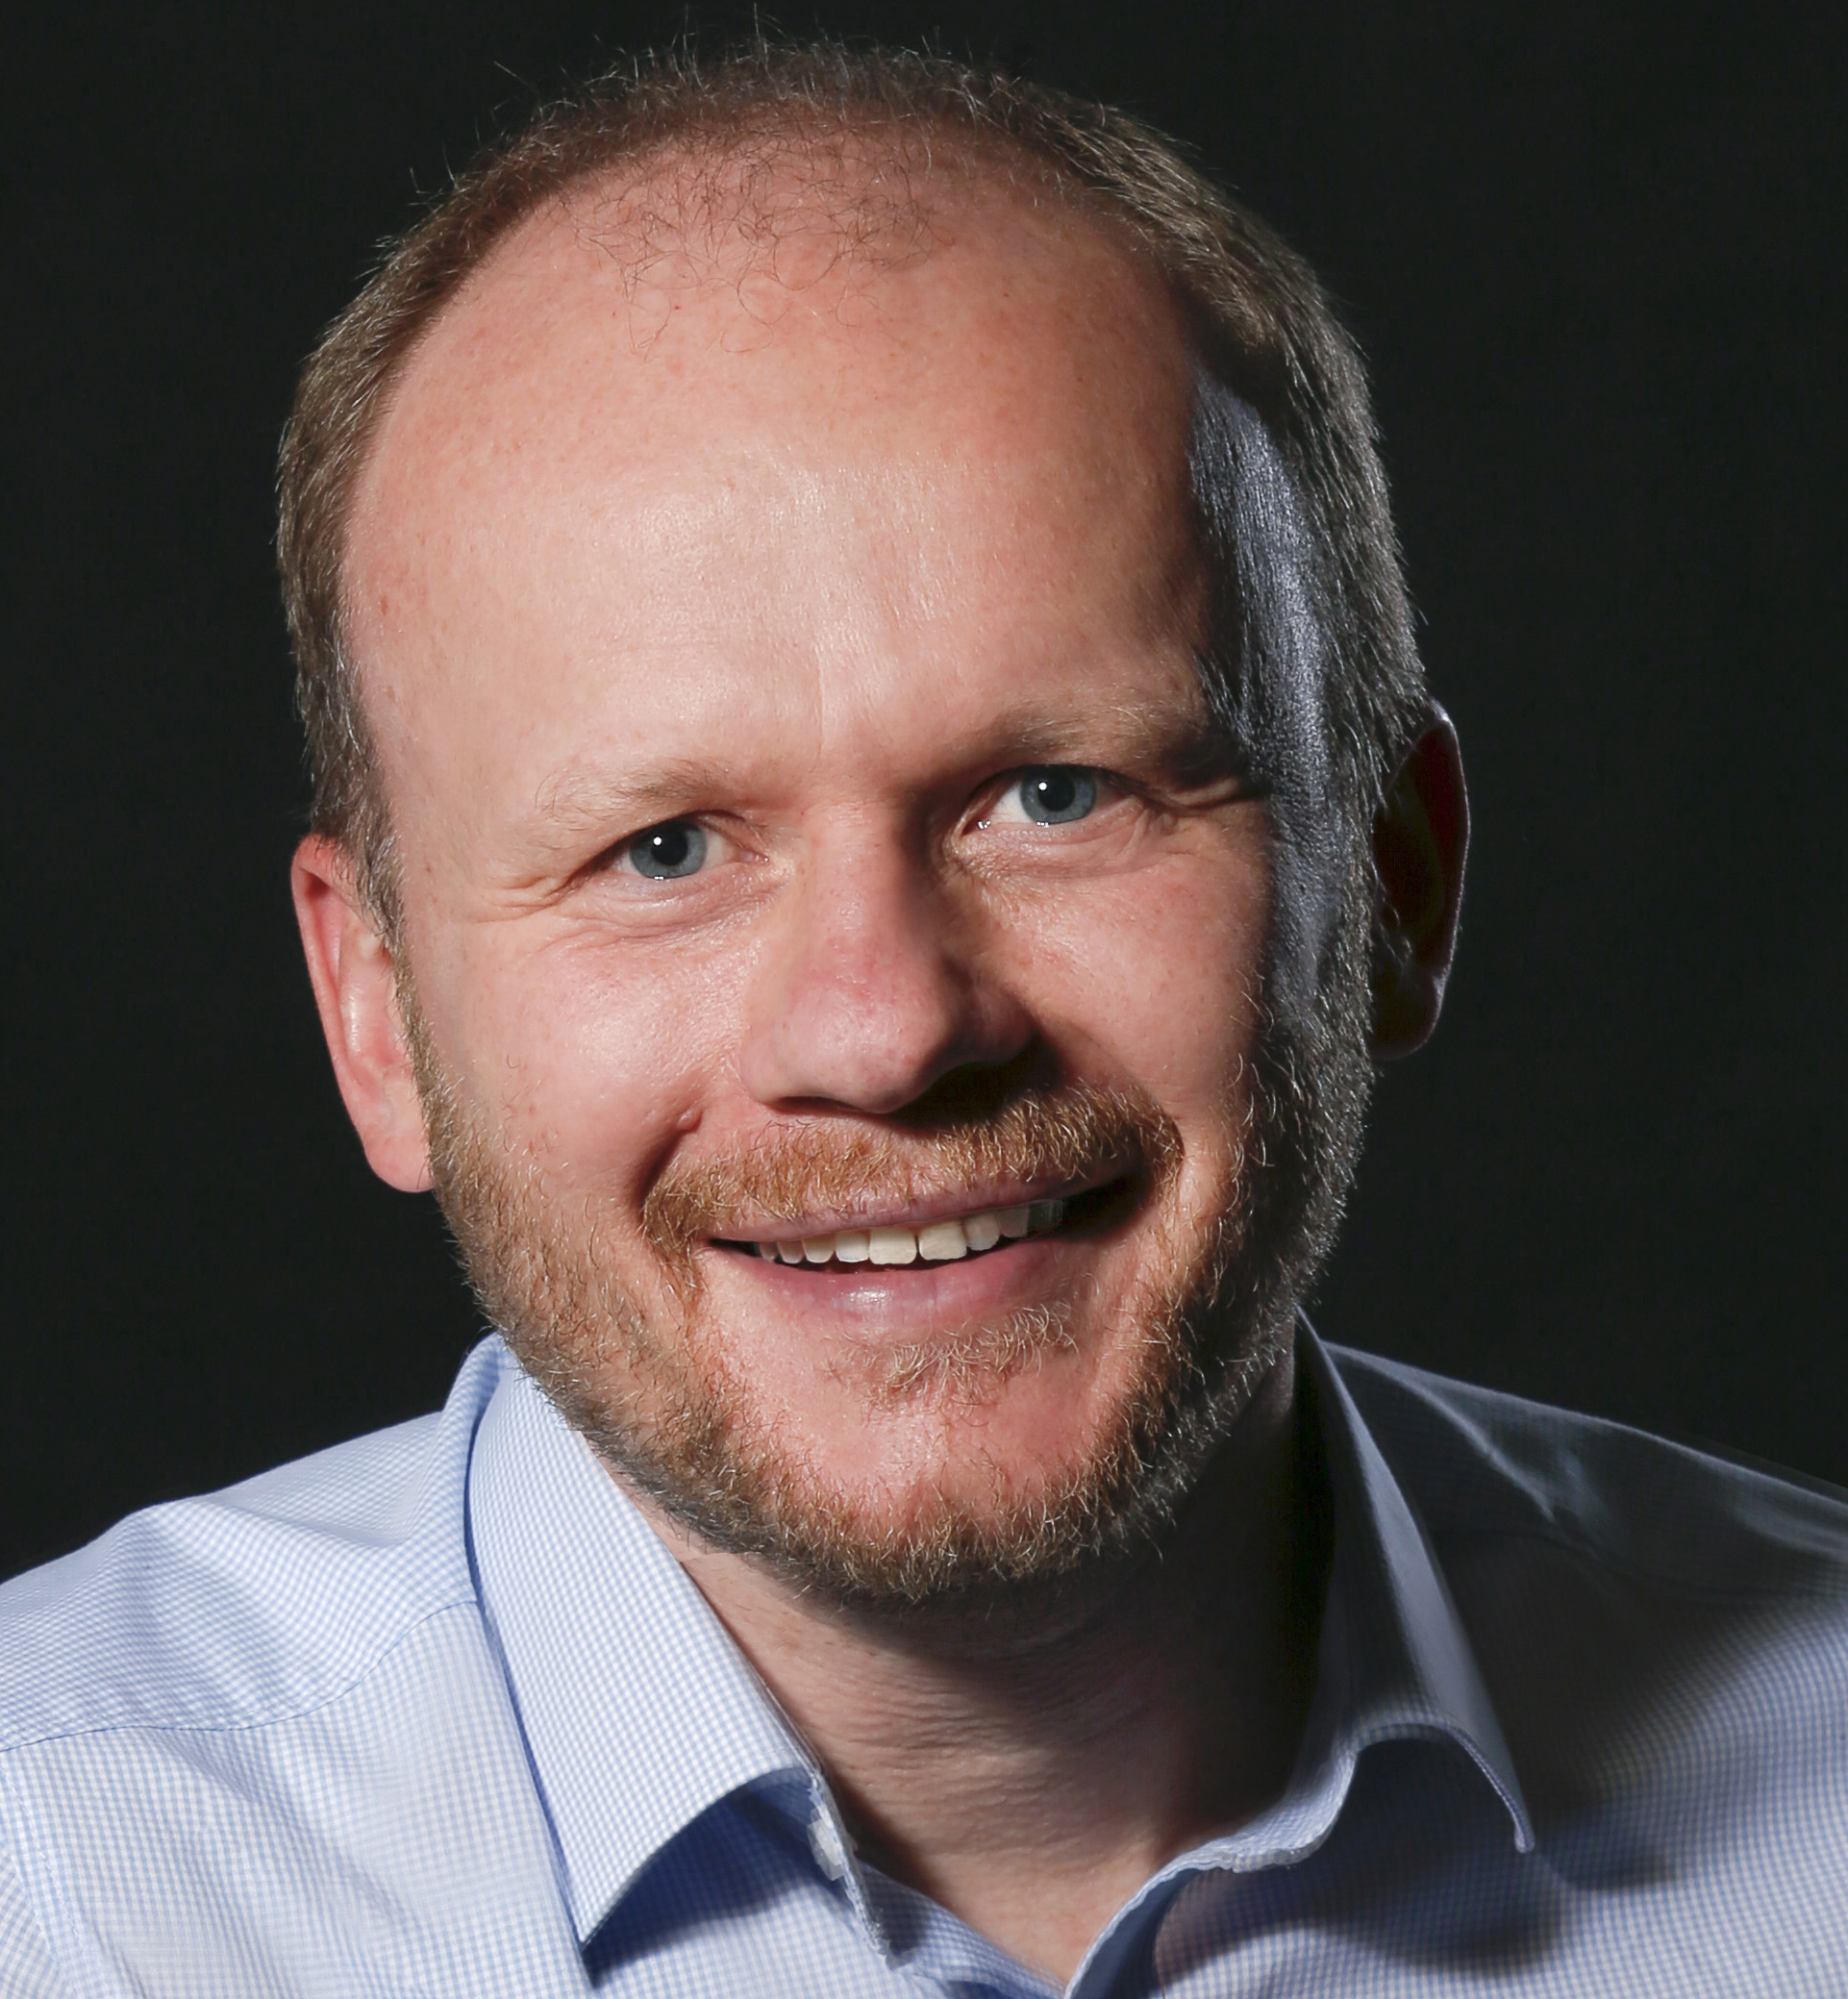
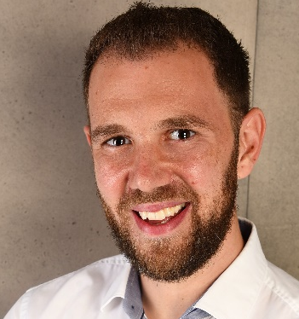
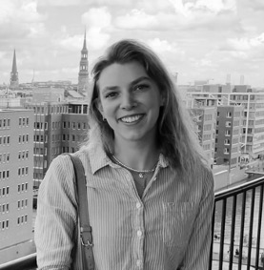



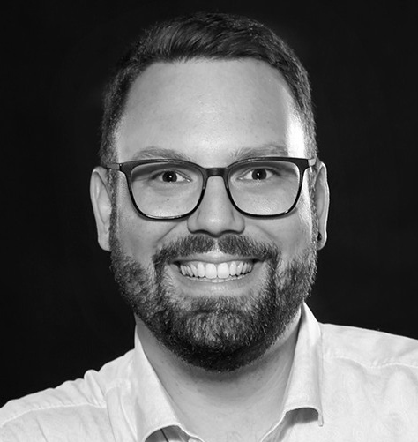
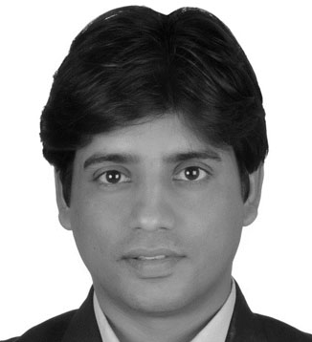
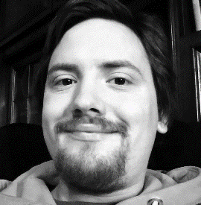




Ambassador Program 2023
Get to know the AskBrian Team
Pavol Sikula
CEO
Matthias Ruppel
CTO
Johanna Wüschner
Working student & Ambassador contact
René Karsch
Business Development
Jeewan Gaur
Product Development
Christopher Schmitt
Software development
More helping hands ☺
Cristian
SW development
Sebastian
SW development
Paulo
SW development
Sonya
Marketing
Milos
Testing
Jakob
Website
Larisa
Operations
Nina
GDPR

Slide 6
FOUNDER‘S
NOTE
FOUNDER‘S NOTE: IT‘S PERSONAL
‘We are building an AI-powered work companion I wish I had during my 15 years in consulting.’’
Platzhalter:
Brian Story
Pavol Sikula
CEO AskBrian

Slide 7
Ambassador Program 2023
The AI Ambassador Program
What are we up to?
With Brian we contribute to the digital workplace of the future. We co-create new work where we humans focus on meaningful tasks, have more time for entrepreneurship and more time to be shared with our loved ones. Our Student Ambassadors help us to achieve our ambitious mission faster!
How is this beneficial for you?
Skills & Knowledge
You will gain valuable skills and knowledge related to promoting and presenting a cutting-edge technology. This experience can be useful in various industries and job positions in the future.
Resume Building:
A certification from a technology company can make your resume stand out to potential employers. The certification demonstrates your passion for technology and your ability to take on a leadership role in promoting it.
Leadership Skills
As a Student Ambassador, you will take on leadership roles in planning and executing the promotion of Brian on your campus. This experience can help you develop leadership skills that will be valuable in your future career.
Network Acceleration
You get opportunities to network with professionals in the technology industry and Ambassadors from student consultancies across Europe. This can be an excellent way to establish connections and seek out future career opportunities.

Slide 8





Ambassador Program 2023
Your responsibilities as our ambassador
Promoting
Events
Network
Feedback
Contribute
Promoting and raising awareness of the AskBrian technology on your campus and within your networks.
Organizing workshops, or presentations to showcase the technology and its benefits.
Networking with professors, student organizations, and other potential partners to increase AskBrians visibility and reach.
Providing feedback and insights on how to improve the Brian technology and its presentation.
Contributing to social media campaigns and online communities to promote Brian.
Student Ambassadors are vital representatives of Brian, responsible for engaging with the community, providing feedback, and driving initiatives to promote our brand. Your contributions are essential to our overall mission.

Slide 9






Ambassador Program 2023
The Ambassador certification process
1) Orientation Session
2) Ambassador Event
Certification
We track your progress (session attendance, communication, events, and Brian usage).
-
Attend an online orientation session to learn about our technology, providing you with the knowledge and skills necessary to promote our technology effectively
Plan and execute a campus-wide event (student consultancy or presentation to showcase our technology to your peers, alumni's, professors, ...
Upon successful completion of these steps, you will receive a certificate of completion and the title of AskBrian Student Ambassador.
3) Story telling
Brian Usage
You will receive feedback on your skills and expertise on LinkedIn from our founder Pavol.
You can attend a mentoring session with Pavol and get insights into the process of funding an AI start-up or general insights and expertise.
Submit a story detailing your experience as a Student Ambassador, including the impact Brian had on your work
Perform a minimum of 30 requests with a minimum of 10 different skills

Slide 10
Ambassador Program 2023
Program rules and guidelines
Main Rules and Guidelines
1
Attendance and punctuality: Be present and arrive on time for all required meetings, events, and activities related to the program, unless you have a valid reason for absence.
2
Professionalism: Always maintain a professional and respectful attitude when representing the program or the institution, whether in person or online.
3
Confidentiality: Keep any information shared with you about the program or the institution confidential and do not disclose it to unauthorized individuals or entities.
4
Code of conduct: Treat everyone with respect, embrace diversity, and promote inclusivity in all your interactions as a student ambassador.
5
Conflict of interest: Disclose any conflicts of interest that may affect your ability to fulfil your role impartially and objectively.
6
Communication and reporting: Regularly communicate with program coordinator (Johanna), provide reports/ stories on your activities, and communicate e.g., events.

Slide 11





Ambassador Program 2023
Your benefits from being Brian Ambassador
Development
Certification
Network
Mentoring
Brian Access
Develop your skills, knowledge and leadership experience
Earn AskBrian’s ambassador certification
Get insights into customer network and leverage upon network opportunities
Personal mentoring by AskBrian founder
Brian Ambassadors get lifelong free Brian access
Student Ambassadors are vital representatives of Brian. Your contributions will help you to gain a new skillset, expand your network and benefit from the unique benefits of AskBrian

Slide 12
BREAK

Slide 13
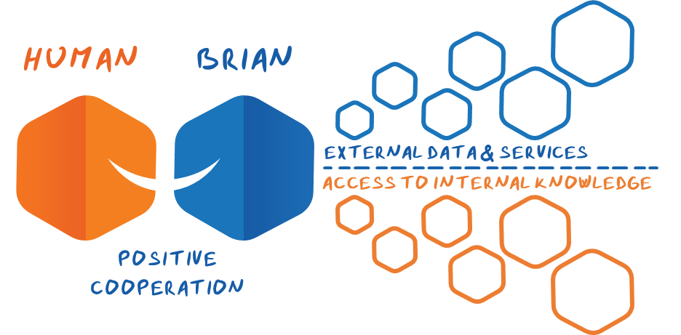




Ambassador Program 2023
Introducing Brian
OUR BRIAN IDEA
KEY CHARACTERISTICS
Multifunctional and simple
Via Email and MS Teams
Answers 24/7 within 3 mins
Secure & GDPR compliant
© AskBrian GmbH 2022. All rights reserved

Slide 14
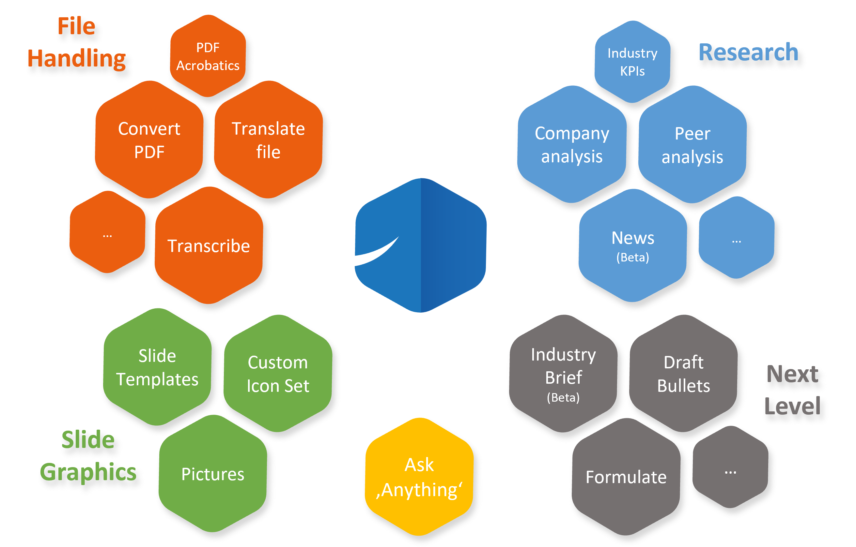
Ambassador Program 2023
Brian's Plug and Play Skills
© AskBrian GmbH 2022. All rights reserved

Slide 15
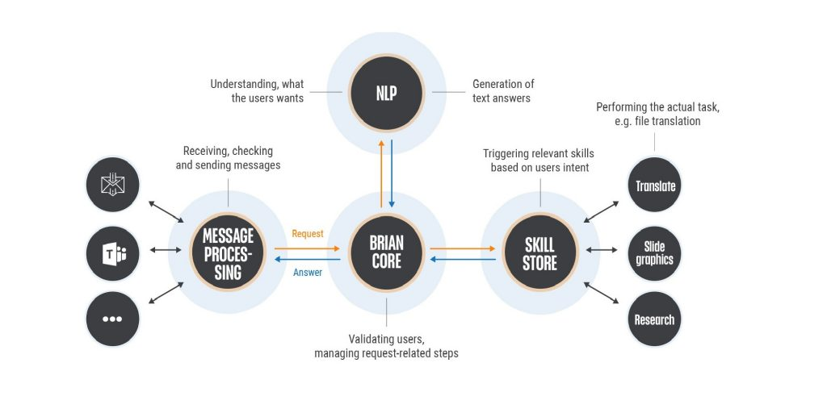
Ambassador Program 2023
Brian architecture, dialogflow and NLP

Slide 16


Ambassador Program 2023
Brian x GPT technology
GPT technology
Training
Grounding
How do we create additional value with GPT technology ?
How do we train Brians skills?
How does grounding work?

Slide 17

Q&A Session

Slide 18
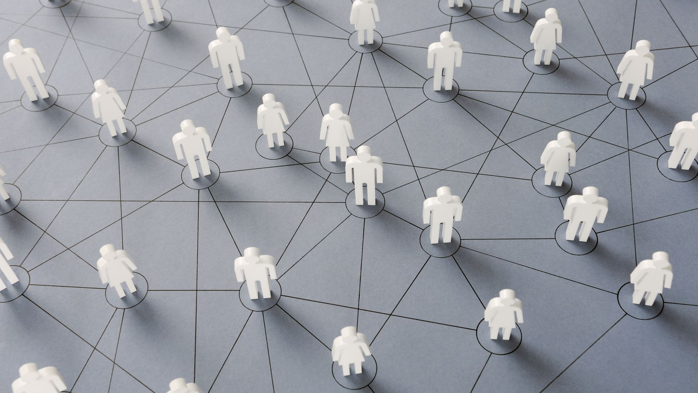
Networking

Slide 19

Ambassador Program 2023
Let's connect and get to know each other !
NETWORK
ICEBREAKER
-
Shortly introduce yourself ☺
Send your LinkedIn profile into the chat so others can easily connect!
Notes:
Desert Island: Ask participants to imagine they are stranded on a desert island and can only bring three items with them. They must then introduce themselves and share what three items they would bring and why.

