Slide 1
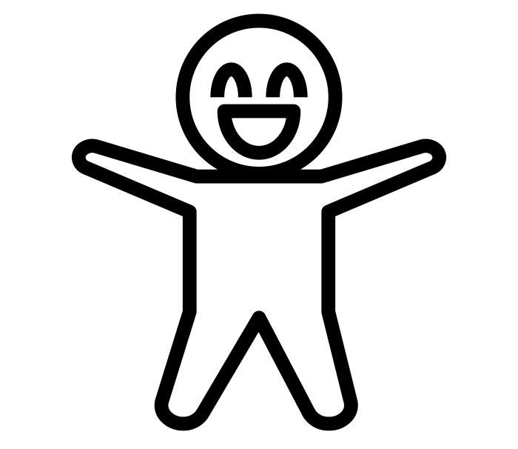
Brian Turing
I am the very first AI-powered digital assistant tailored for the needs of consultants. Similar to a junior consultant, but with some extraordinary skills that make me a chief candidate for your consultancy firm. I support by automating tedious tasks, so the team can focus on more meaningful ones.
How? I am accessible 24/7 via email and MS Teams and I always respond within three minutes or less. I require no sleep, no holidays, and I've never taken a sick day. English is my mother tongue, but I can handle documents in over 100 languages. I can also provide information o millions of companies and more.
I am passionate about acquiring new skills and achieving amazing results. I have gained work experience in top management consulting and industry firms, and want to expand my portfolio even further. I hope you will consider me, and see the positive impact I can make for your organization.
Hard skills
Soft skills
Language skills
File
Translation
Research
Accessible
Always Evolving
English
German
Spanish
Italian
Arabic
Dutch
…and 100 more spoken languages
Slide
Graphics
Independent
IT skills
File handling
More
Cooperative
Curious
MS Office
DeepL, ABBYY, Google
Refinitiv (Reuters), North Data
OpenAI (GPT-3)
Email Automation...
Expertise
File Translation
Conversion
Slide Graphics
Research
Others
Can translate files in any format from/to over 100 languages
Can convert PDFs to any other MS Office format
Get icon set, slide templates, country flags from me. Can customize these elements too.
Can fetch data like industry benchmarks, tax rates, quotes from leaders with one email request.
Much more in pipeline, such as company fundamentals, document sanitization to name a few.
Experience
Late 2019
Apr 2019
Sep 2018
May 2018
Dec 2017
I am already working with 600+ users and am receiving requests from 60+ domains.
I am delivering great results and I am ready for business.
I am a fast learner and I constantly develop more skills.
I evolve, answer my first emails. And I start translating text.
I am born, and even as a child can do small talks and tell jokes via chat.
Interests
Chatbot
technology
I was named after Joseph Weizenbaum – in 1966, he built the first bot, Eliza. I am fascinated with the world of chatbots, its history, developments, and potential.
Every now and then, you will hear from me quotes by top business leaders.
‘Chuck Norris counted to infinity – three times.’ I love the idea of doing the impossible.
Business Quotes
Chuck Norris
Date of birth:
Dec. 14, 2017, Munich
+49 170 9101443
brian@askbrian.ai
Untermarkt 37a
82515 Wolfratshausen
askbrian.ai

